Slide 1
Shiny Project
Chicago Taxi Trips

Slide 2

The Data
Found on Kaggle.com: Chicago Taxi Trips
Data accessed through Google BigQuery
Full data from Query was huge (70gb)
Took subset of only September 2019 using BigQuery
Still 1M rows, cleaned with R
Removed Unused Features, Missing Values, and small frequency Taxi Companies
Features Used: Trip Duration, Trip Distance, Community Area Start/End Points, Fare, Tips, Company

Slide 3

Why do We care & Questions of Interest
For a resident of Chicago that frequents Taxi Cabs, knowing the data might help them save some money.
From point A to point B, which is the most popular Taxicab company?
Which company has the lowest fares between these points?
How long should I expect the taxi ride to be between these points?
How much should I tip?

Slide 4
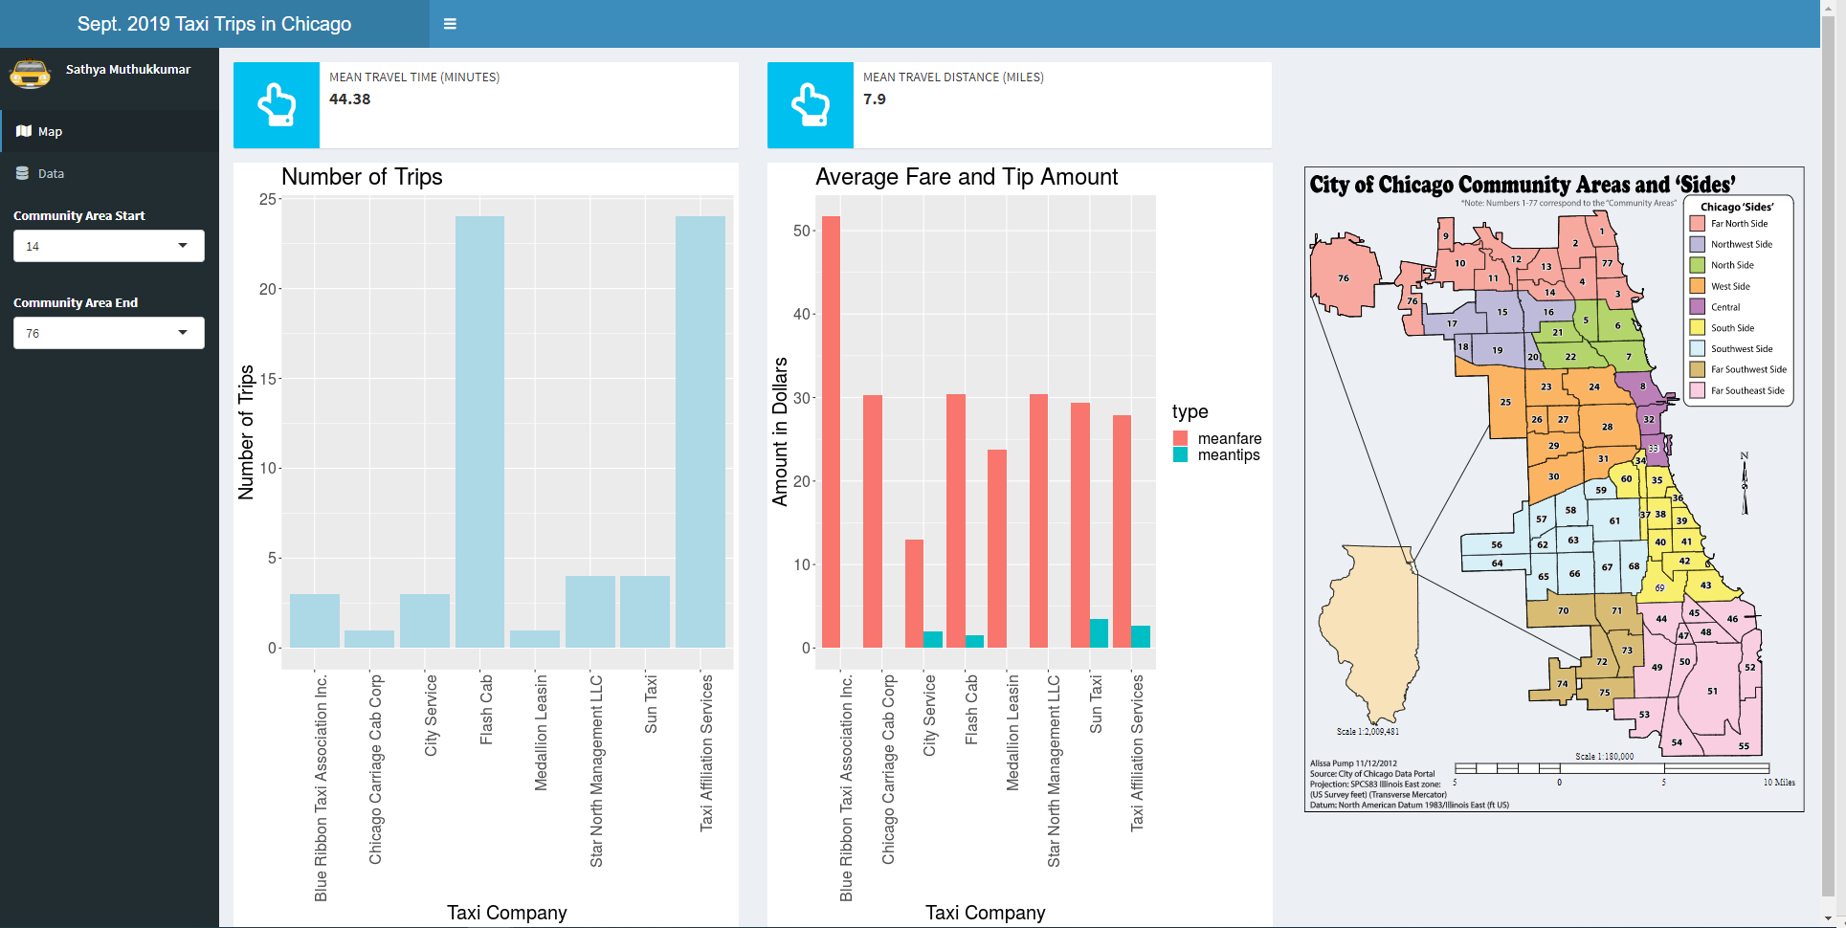
The Shiny App

Slide 5

Future Work
Would really like to query and use the whole data set, there are some instances of only a few trips between two community points (subset was only 1 month, yet full dataset is over 6 years)
Incorporate more features through additional tabs, such as day of the week trip frequencies.
Analyze changes of features over time, across years of data.

Slide 6
End

